Slide 1
Dinosaur Runner
By: Jimin, Kevin, Shritek, Yao, Kai

Slide 2
Monster Runner
By: Jimin, Kevin, Shritek, Yao, Kai

Slide 3

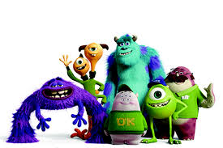
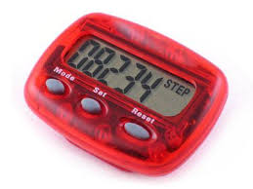
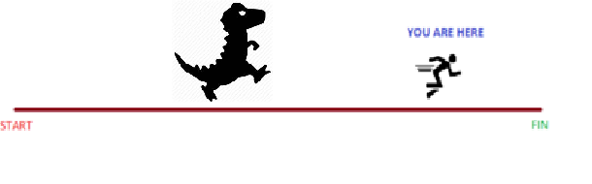
Introduction

Slide 4
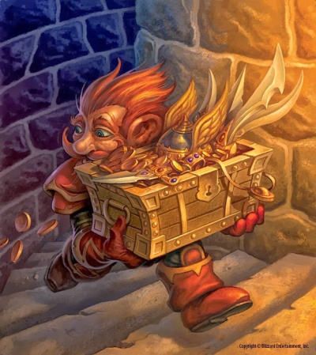

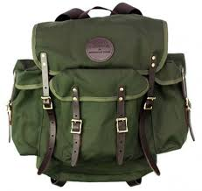
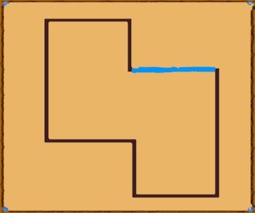
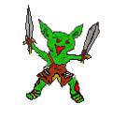





New Additions

Slide 5

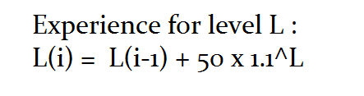
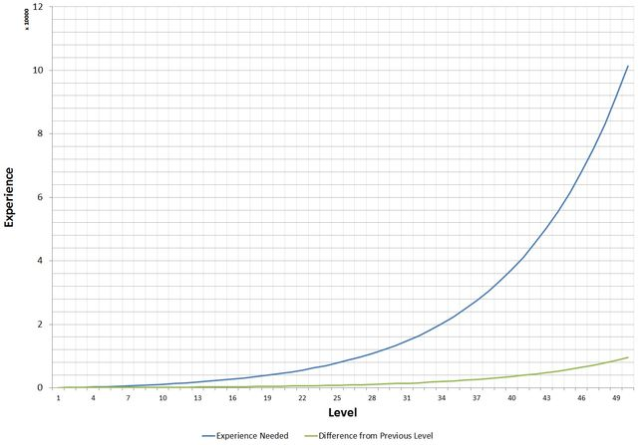
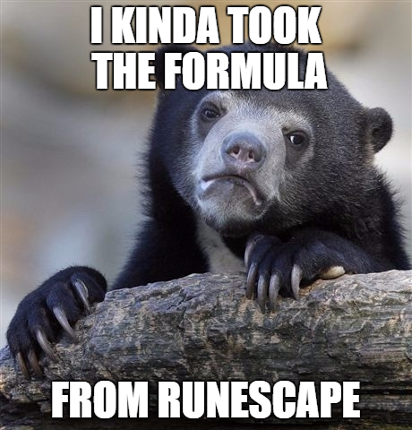

We Love Math

Slide 6
Live Demo
LET’S PLAY!

Slide 7
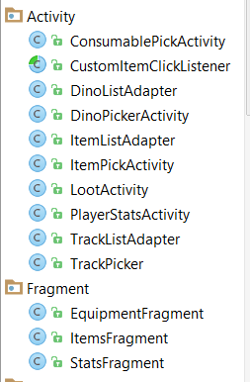
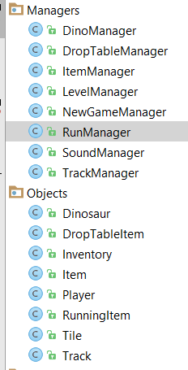
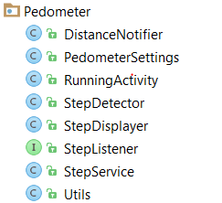
Overview of Development

Slide 8
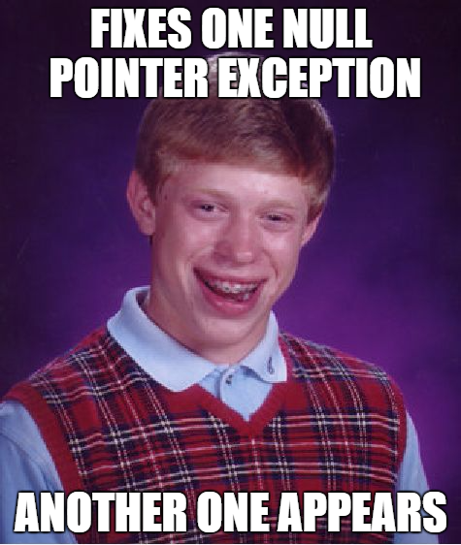
Challenges

Slide 9
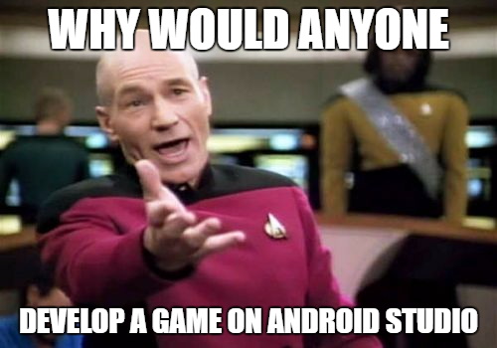
Meme Challenged

Slide 10
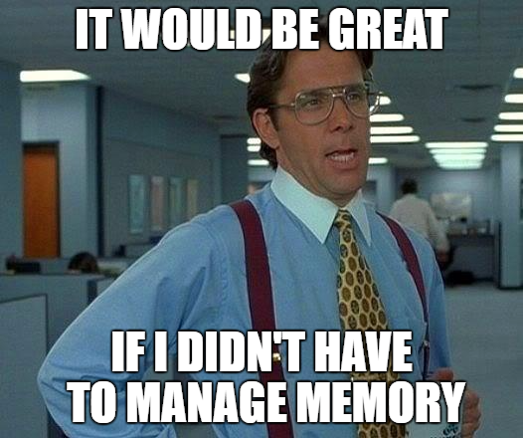
Meme Challenged

Slide 11
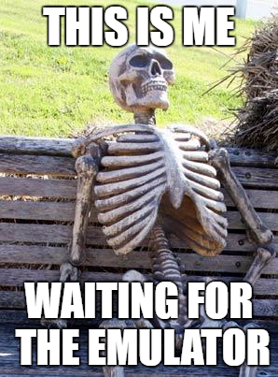
Meme Challenged

Slide 12
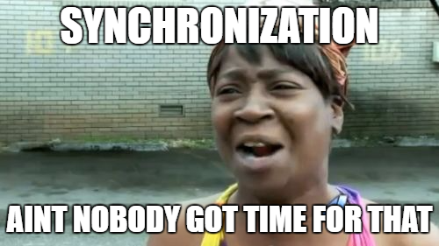
Meme Challenged

Slide 13
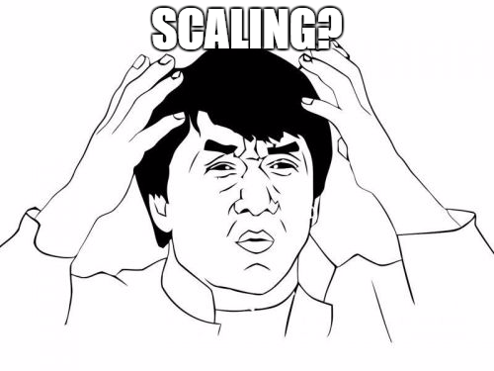
Meme Challenged

Slide 14
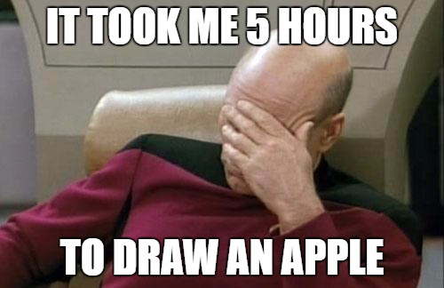
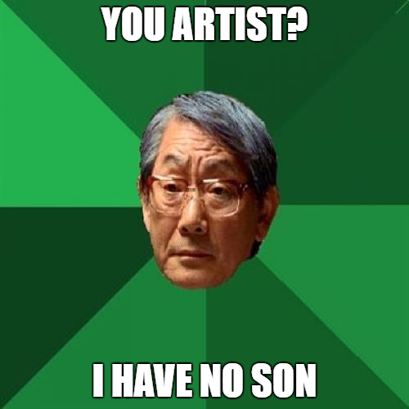
Meme Challenged

Slide 15
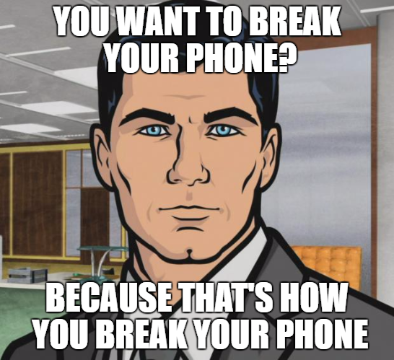
Meme Challenged

Slide 16
Goals and Ideas
Story Mode
Trading
Additional Content
Status Effects
CRAFTING
Character customization with skill points
Immersive Sound

Slide 17
Even Bigger Goals
Google Play - Badges
Auction House for items
Boss Mechanics (Code AI for specific Tracks)
UNITY???
User Generated Content
A summer blockbuster release

Slide 18
Questions?
Thanks for watching

